Slide 1
23 Financial Tips 2023 @laresepurnell
LaRese Purnell, MBA
Managing Partner
CLE Consulting Firm

Slide 2
What is your last name worth today and what will it be worth when you leave this earth?

Slide 3
If you died today, what would your loved ones do without you, and would they be prepared financially?

Slide 4
Alarming Statistics

Slide 7
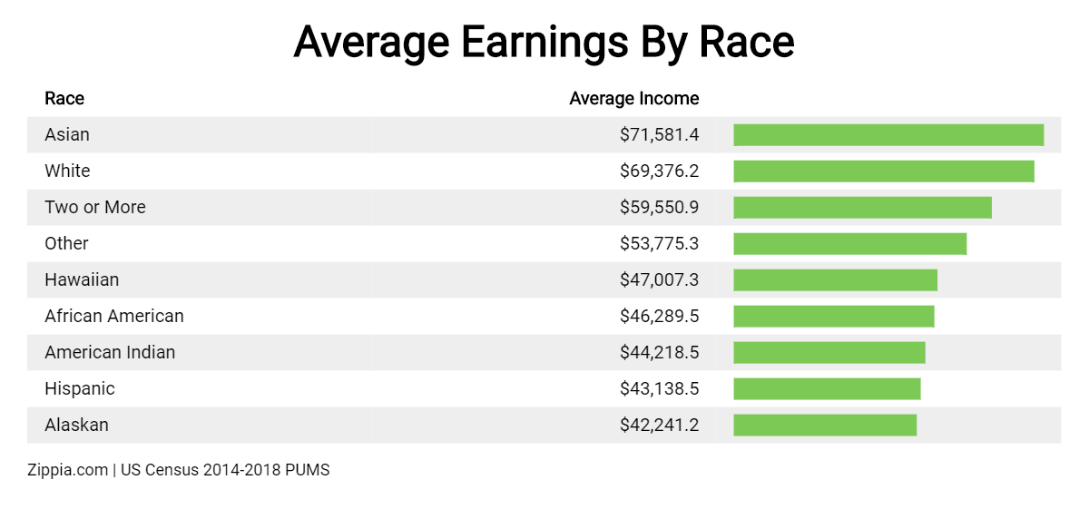

Slide 9
Use This Rule
21/90
Its takes 21 days to build a habit and 90 days to build a lifestyle.

Slide 10
Refinance or Consolidate “ALL” debts
ex. Mortgage, Credit Cards or Vehicle (Weekly or Bi-Weekly Payments Only)
Utilize local Credit Union, Faith Community United Credit Union (0% Offers)
Downsize – Home or Vehicle
Research rates are www.bankrate.com
Create your Power of Five
Accountant, Lawyer, Insurance Broker, Financial Advisor and Banker
(HR &Marketing)
Build your money team based on relationships, accountability, referrals, strategy alignment and expertise/credentials. (Fiduciary)(CFP)-Board Site
Start a Roth IRA (100% $6.5K), SEP or Simple IRA
Meet with your Financial or Investment Advisor (Bi-Annually)
Consider a Roth for your minor’s (*Entrepreneurs $6,500 Roth and $6,000 Pay)
$6,500 per year, $1,000 catch up over 50 ($7,500)
Roth (Tax-free) vs. Traditional (Tax-deferred) – Convert to a Roth at low-income year
Create investment strategies to prepare for retirement, education and business needs
Exercise: www.ssa.gov

Slide 11
4. Open an HSA (Health Savings Account)/ FSA (Flexible Savings Plan)
Pre-tax medical expenses
Reduce your taxable income
Self-Only Coverage $3,850, Family Coverage $7,750 (2023 Up 5%)
Age 55+ $1,000 catch up
Purchase or Increase Life Insurance (Permanent, Variable or Term)
Purchase whole life for kids at a young age – cash value strategy
Possible investment vehicle
Employer or individually owned policies (Portable)
Purchase at least 10-15 times your annual income (age of your child)
Exercise: www.lifehappens.org
6. Start or maximize your 401K (max. $22,500)(2023)
Create tax strategy, to reduce liability and increase after tax wealth
Explore your full retirement plan make sure if aligns with future goals
Maximize your match
1-3% Increase each year
Catch up over 50 - $7,500 total of $30,000
Beneficiaries Updates

Slide 12
Proverbs 13:22 (King James)
A good man leaveth an inheritance to his children's children: and the wealth of the sinner is laid up for the just.

Slide 13
21 Financial tips for 2021
7. Establish a Family Trust Agreement/ Estate Plan to protect all your assets
Meet with attorney and/or financial institution
Avoid probate and properly transfer assets while still living
Tax benefits
8. Create, Discuss and Update your Will
Discuss and Establish beneficiaries (Annually or Based on Life Changes)
Designate Executor, Guardianship and Avoid Probate
Create and Notarize Original Copy
9. Create a Durable Power of Attorney (POA), Health Care Proxy/ Advance Medical Directive
10. Review your Annual Taxes
Include all expenses
Adjust tax deductions with your employer to breakeven
Maximum all possible deductions
Fill out a tax organizer

Slide 14
You have been paying your tax bill and leaving the IRS a Tip

Slide 15
11. Purchase a Home or Rental Property (Duplex)
Real Estate Investments – Landbank, CDC or County Sheriff Auctions
Research Bank websites for foreclosures
County Auditor Site – Value of Home
28/36 Rule (28% of gross income and 36% of your total debt)
12.Create an Online Business or another Stream of Income (Digital Business)
Turo, Airbnb, Virtual Assistant, Amazon Store, Vending Machines, Dog Walker, Cleaning Company, ATM Business, Dividend Stocks
Properly Establish that business, AOI, Tax ID and Business Credit
Exercise: Sample business plans at sba.gov
13.Open a Savings account, Brokerage or Money Market account
Automate (ACH) your age per paycheck(save at least 10%)
Create an emergency fund (20 miles from your home), No debit card
3-6 months of monthly obligations on hand (Interest Bearing)

Slide 16
14. Money Purpose Challenge (Separate Personal vs. Business)
Review the last 60 days of your bank statements
3 Highlighters (Wants, Needs and Saving)
15. Create and embrace a BUDGET
Set monthly spending limit (Add non-essentials)
Implement 50/20/30 Plan (30= 10% Savings, 10% Investments and 10% Tithing)
Zero Based Method (Assign Each $) or Half Payment Method (Split)
Share with others
Review quarterly and reset annually
Make necessary sacrifices
Exercise: Utilize Technology
(3) Paycheck Month (Reinvest Mortgage, Investment)
16.Get an Identity Theft program
Free Bank Offerings
Credit Card Companies
17. Negotiate existing bills, debts and increase and decrease rates
Reduce interest rates
Open your bills and emails
Understand all your income and how to control and direct your money
Build a strong foundation. Just because you make it don’t mean you should waste it.

Slide 17
Malachi 3:10 (NIV)
Bring the whole tithe into the storehouse, that there may be food in my house. Test me in this,” says the Lord Almighty, “and see if I will not throw open the floodgates of heaven and pour out so much blessing that there will not be room enough to store it

Slide 18
18. Create a Strategy to build your Credit Score (CLUB 800)
Credit Karma, WeBULL and CreditReport.com
Turn Good credit into Cash (This is Good Debt)
Youth as Additional User
19. Sell all Unused Items, stop all Free Trials and Unused Memberships
Gym, Apps, Subscriptions, Carwash and etc.
20. Clear up app space for Financial Tool Apps (Match $ vs. Entertainment)
21. Personal Financial Statement (PFS)
What is your Net worth?
Assets vs. Liabilities
22. Every Sunday for 1-2 hours (12 Weeks)
How much time do you currently spend reviewing your finances?
Do a zoom meeting with you family or friends
Money Showers, Purpose Parties
23. Create the LEGACY Box

Slide 19
Tax Preparation Options
TCE – Call 888-227-7669
VITA – IRS.GOV

Slide 20
Helpful Websites
Budget
www.mint.com
www.budgettracker.com
www.budgetpulse.com
Technology
www.quickbooksonline.com
www.freshbooks.com
Credit Report and Score
www.wallethub.com
www.creditkarma.com
www.annualcreditreport.com
www.creditreport.com
Student Loans
www.nslds.ed.gov
Business Credit
www.dnb.com
Insurance
www.lifehappens.org
Business Plan
www.sba.gov
www.score.org
Legal
www.irs.gov
www.rocketlawyer.gov
www.legalzoom.com
Interest Rates
www.bankrate.com
Taxes
www.irs.gov
www.cleconsultingfirm.com
Accounting
www.quickbooksonline.com
www.freshbooks.com
www.zero.com
CRM
www.financialcents.com
www.capsule.com
www.salesforce.com

Slide 21
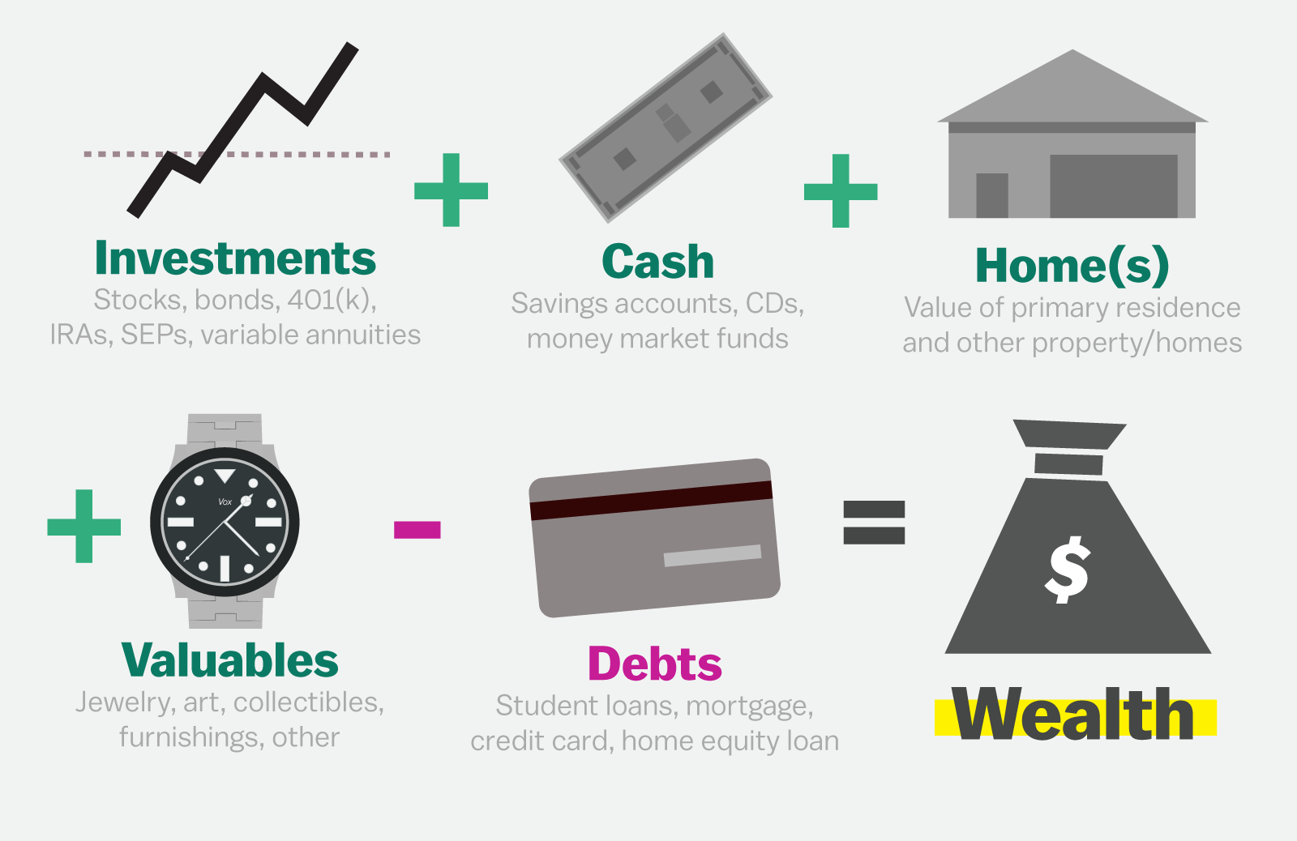

Slide 22
How To Stay Connected
To volunteer, attend or support:
Website – www.cleconsultingfirm.com
Social Media – Instagram, Facebook, Twitter
@laresepurnell @cleconsultingfirm
3. Email – laresepurnell@cleconsultingfirm.com
4. Contact – 216-800-9021

Slide 23
Cash APP $larese1 ($20) Put Your Address in the Memo www.unexpectedbook.com

